Slide 1
Business to Business event Reinventing our High Street: Embracing online retailing

Slide 2
AGENDA
Alan Bewley – Opposites
Where are we now,
Where are we going
How we independents can potentially harness the power of the internet
Clive Hall –
Digital Mobile Marketing
Adrian Robson (Edwards) & James Norris (John Norris of Penrith)
Questions & Answers

Slide 3
Allan Bewley – Oppo-sites
How to make the most of the internet and e-commerce

Slide 4
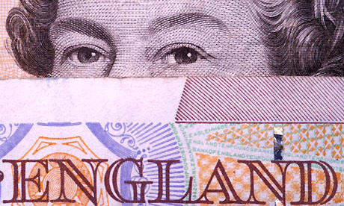

Slide 6
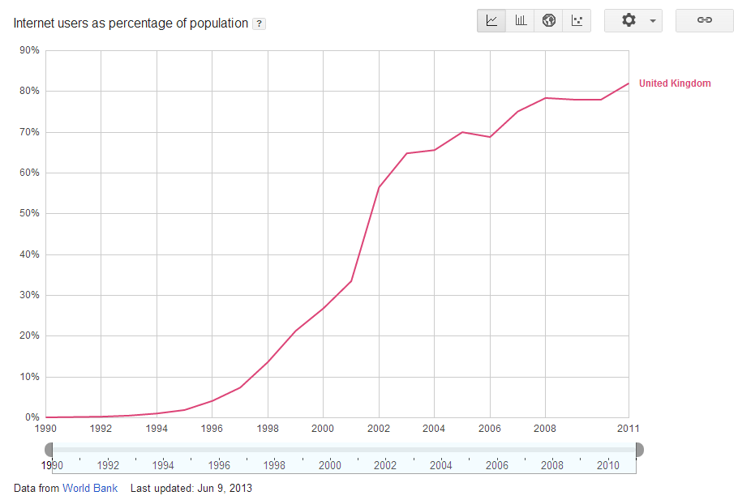

Slide 7
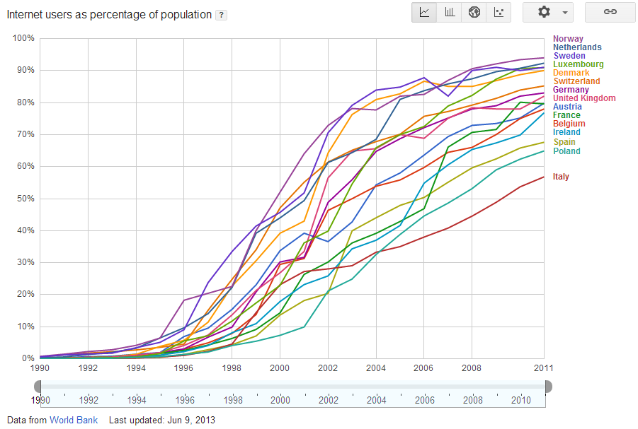

Slide 9
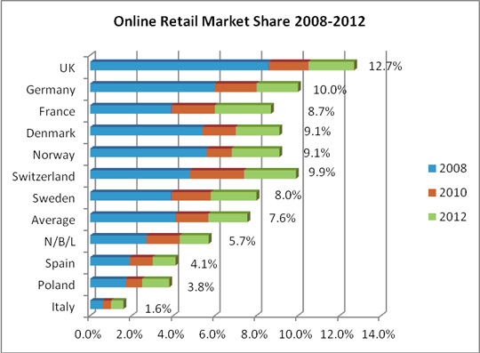

Slide 10
21.5%
by 2018

Slide 11
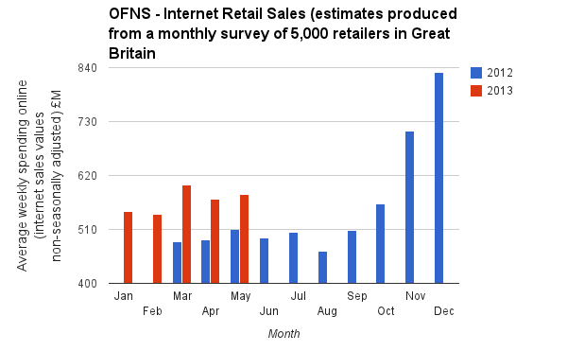

Slide 12
+ 14.7%

Slide 14
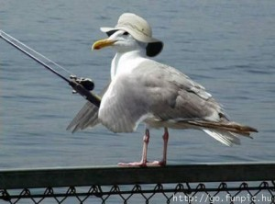

Slide 15
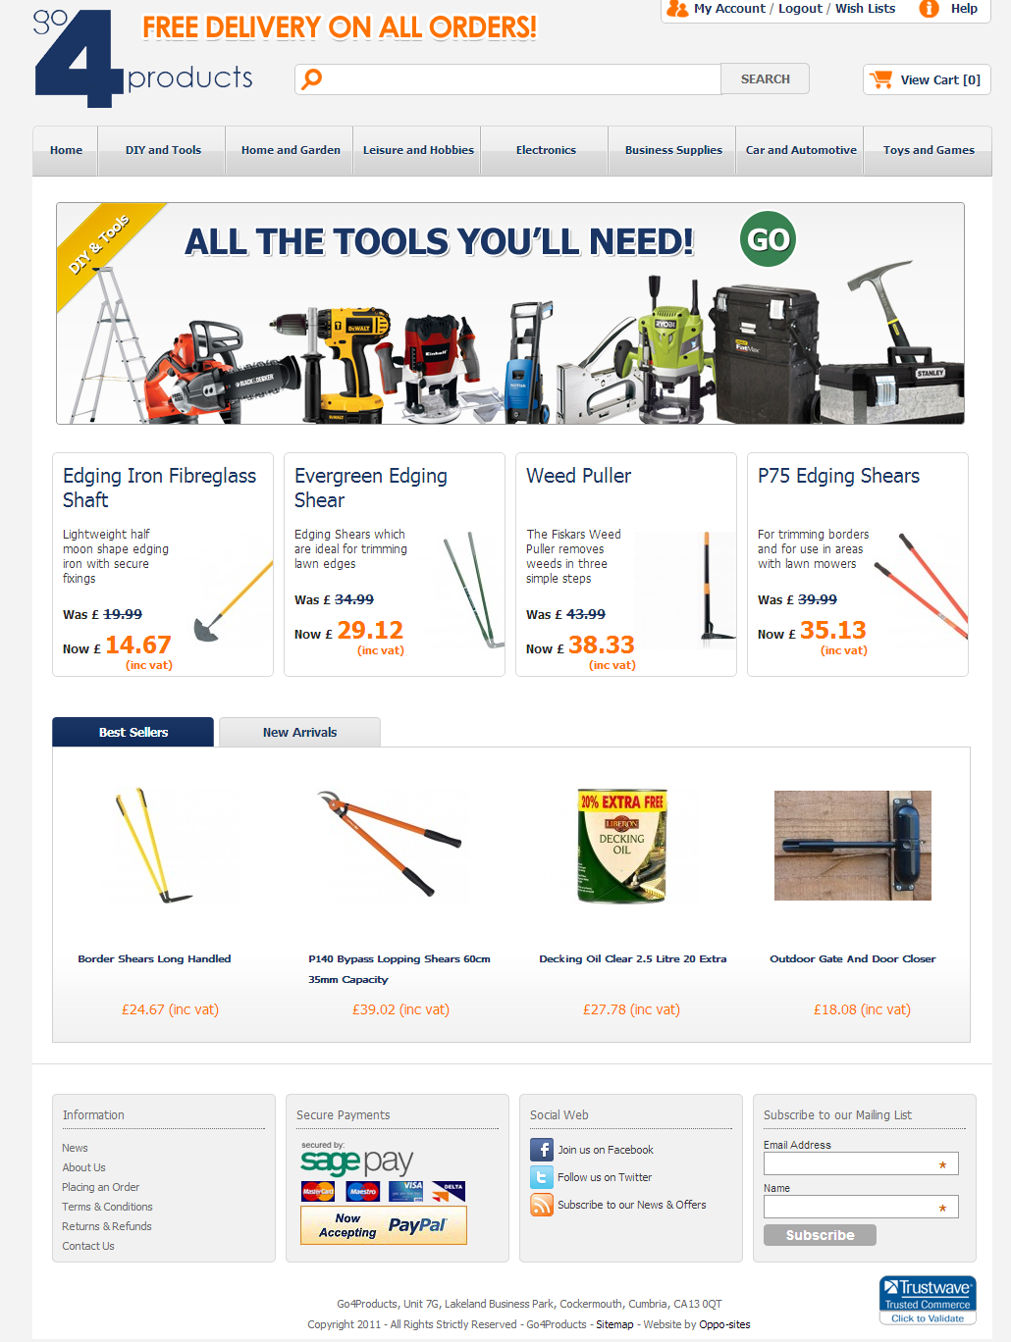
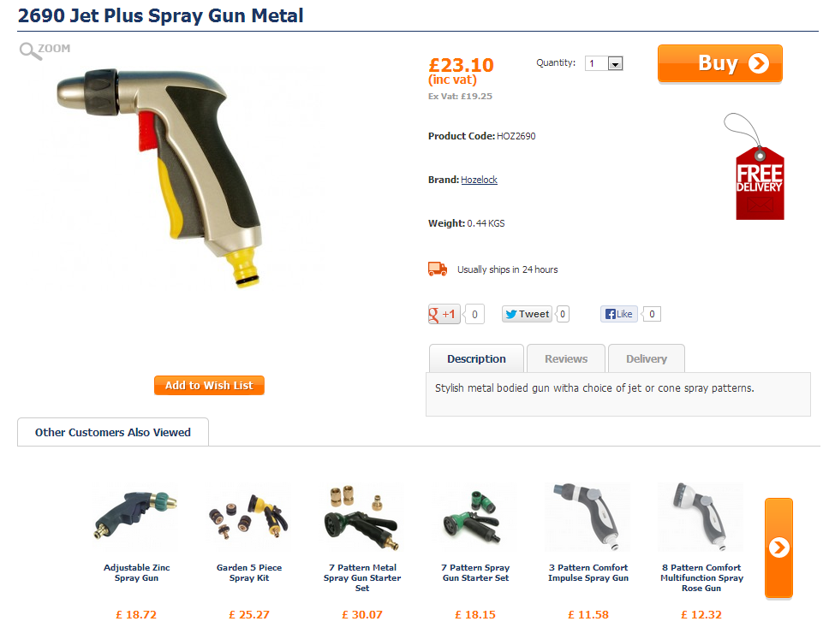
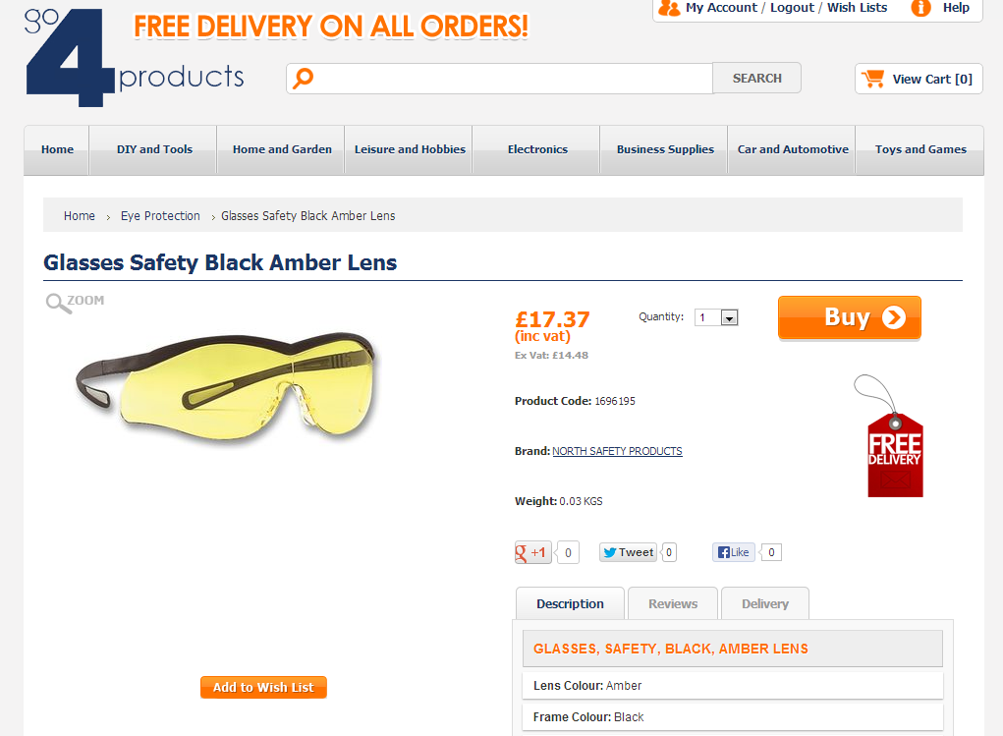

Slide 17
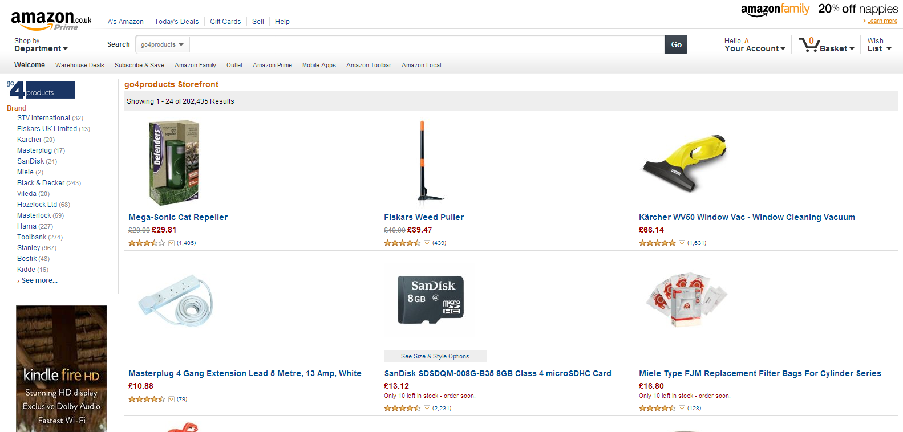
Currently have approx 282,000 products on Amazon

Slide 18
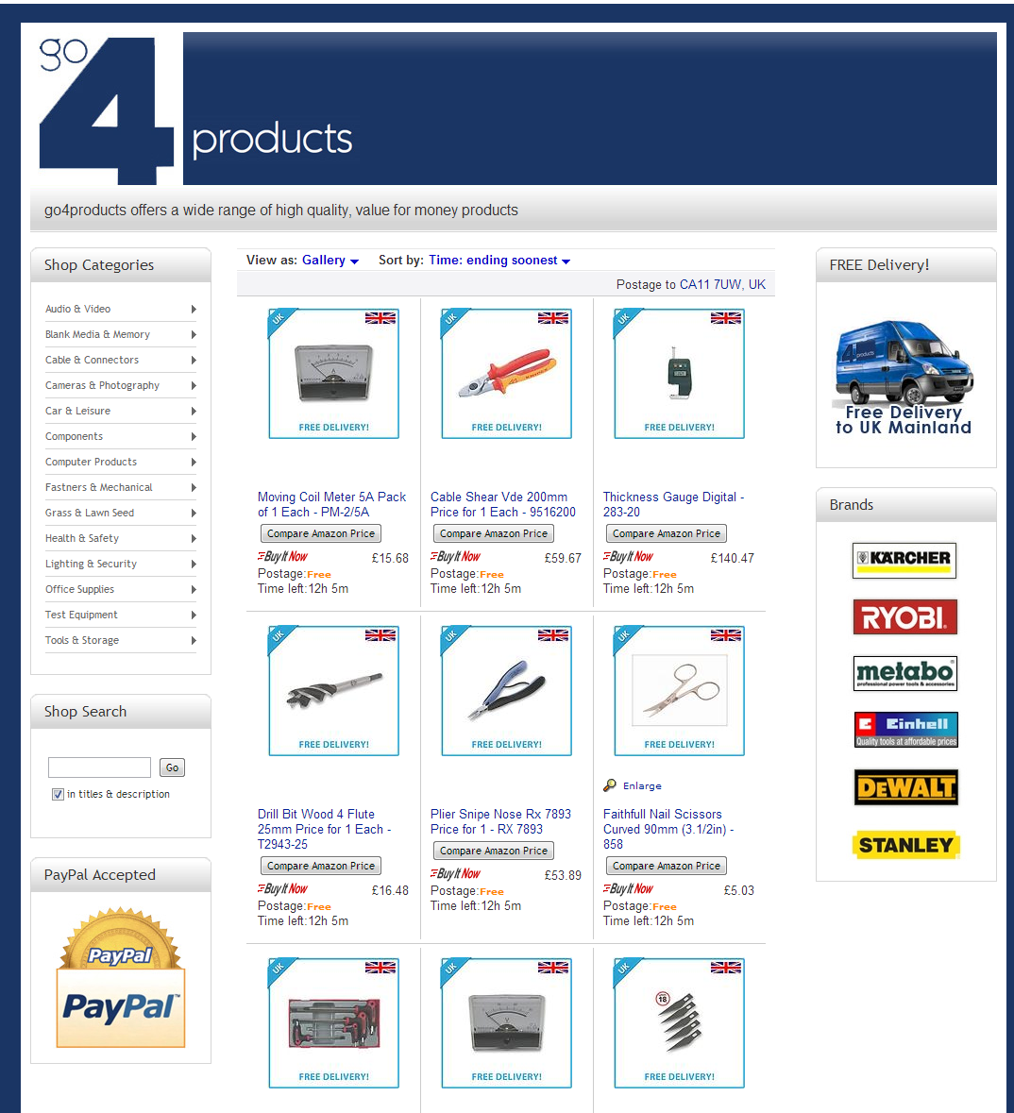
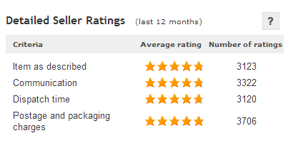
Currently have approx 70,000 products on ebay

Slide 19
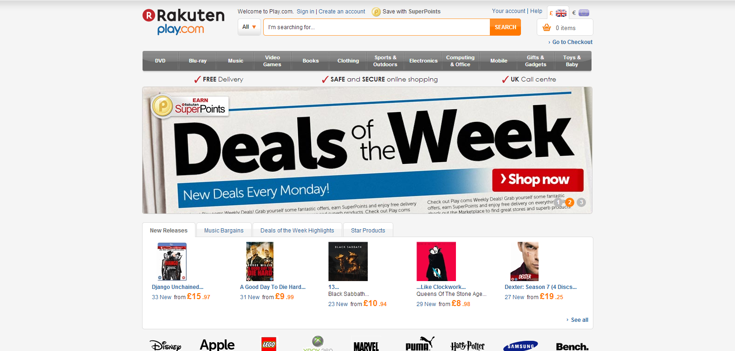

Slide 20
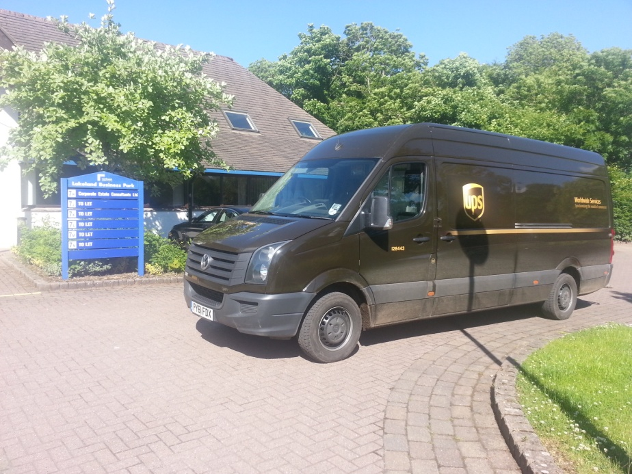
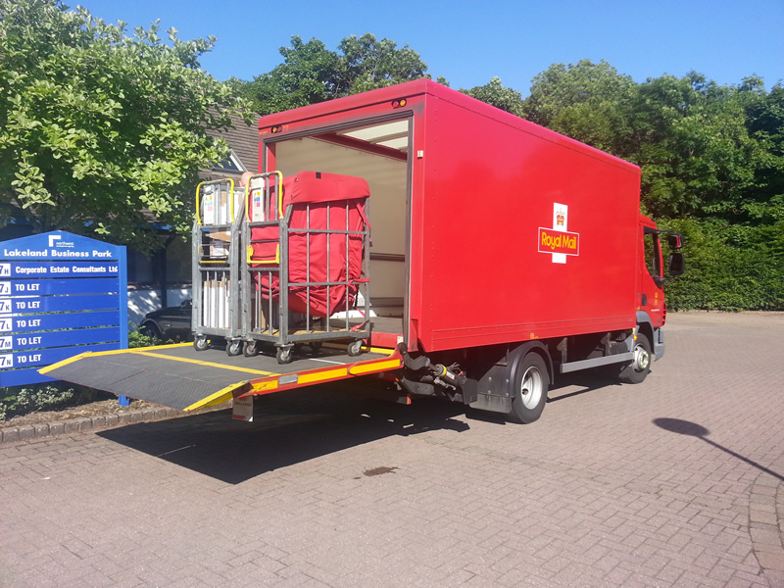

Slide 21
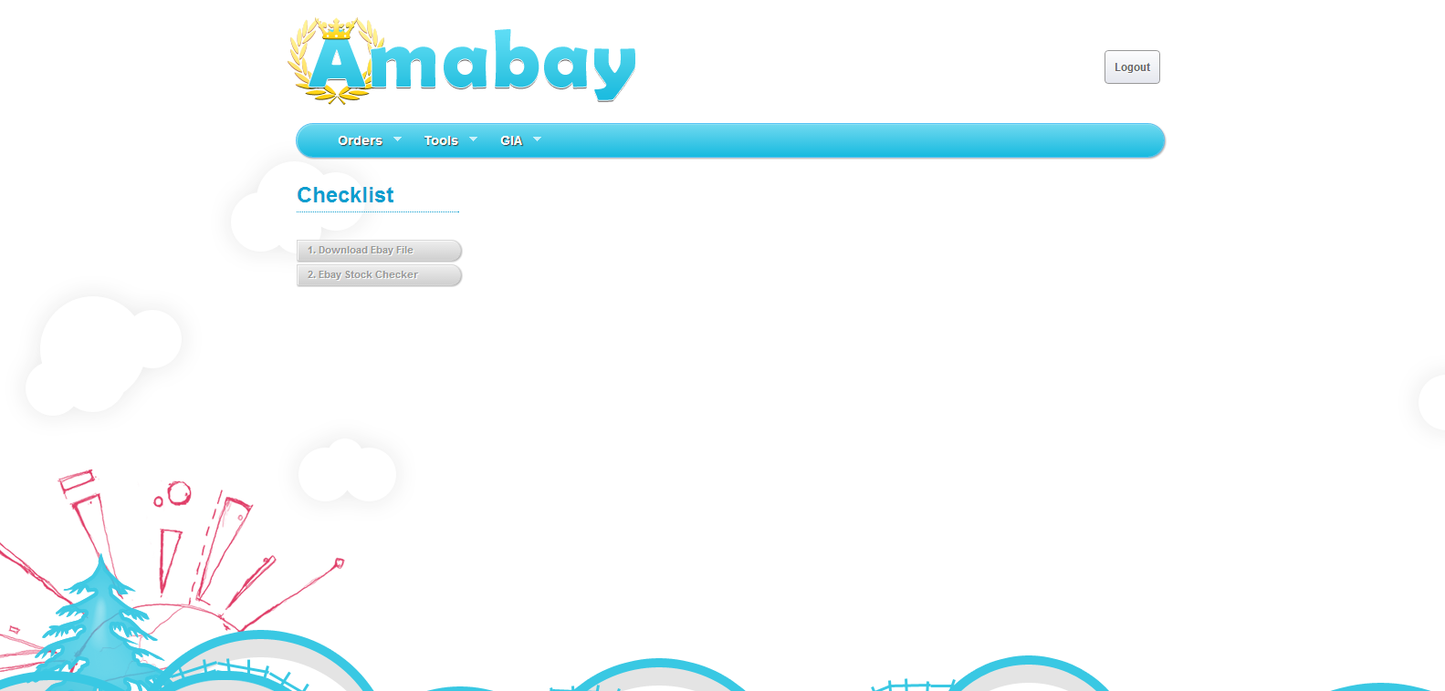
Developed our own in-house order management and stock checking system
Suppliers push data to our server
Reliable stock is vital!
Checking over 350,000 items daily for price changes and availability

Slide 23
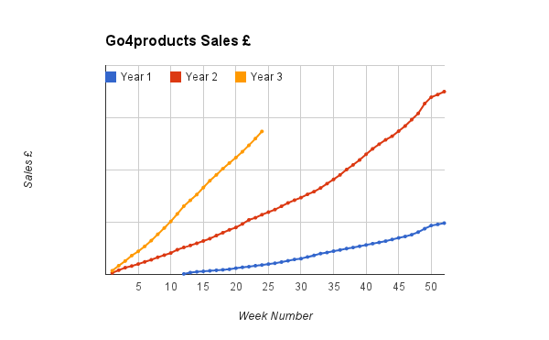

Slide 24
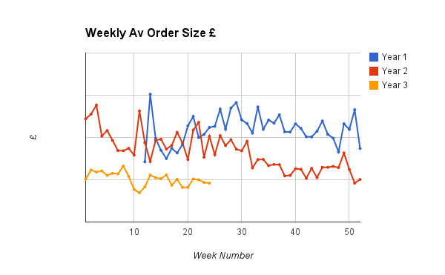

Slide 25
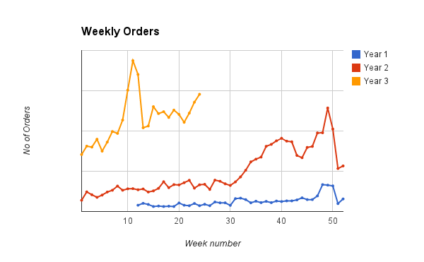

Slide 26
Future Trends
Sales of tablets such as Apple's iPad and Samsung's Galaxy are expected to outsell desktop computers for the first time this year.
The number of tablets sold this year is expected to increase by almost 50 per cent, to over 190 million units.
The smartphone market is expected to grow 27 per cent this year to over 900 million units sold.
By 2017, IDC predicts that over 350 million tablets will be sold per year, closing the gap on the 1.5 billion smartphones it estimates will be sold that year.

Slide 27
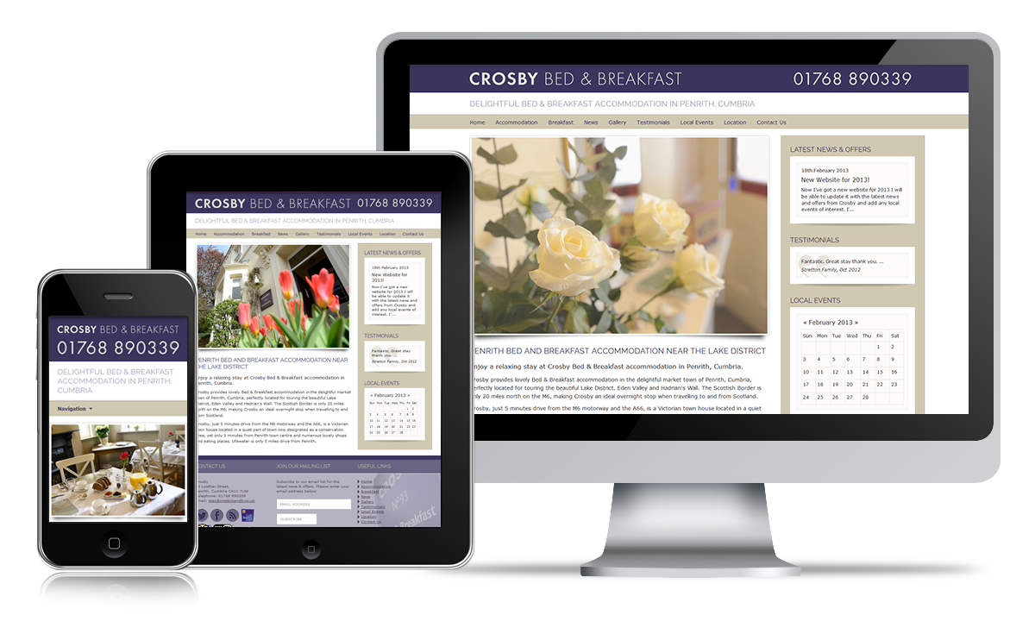

Slide 28
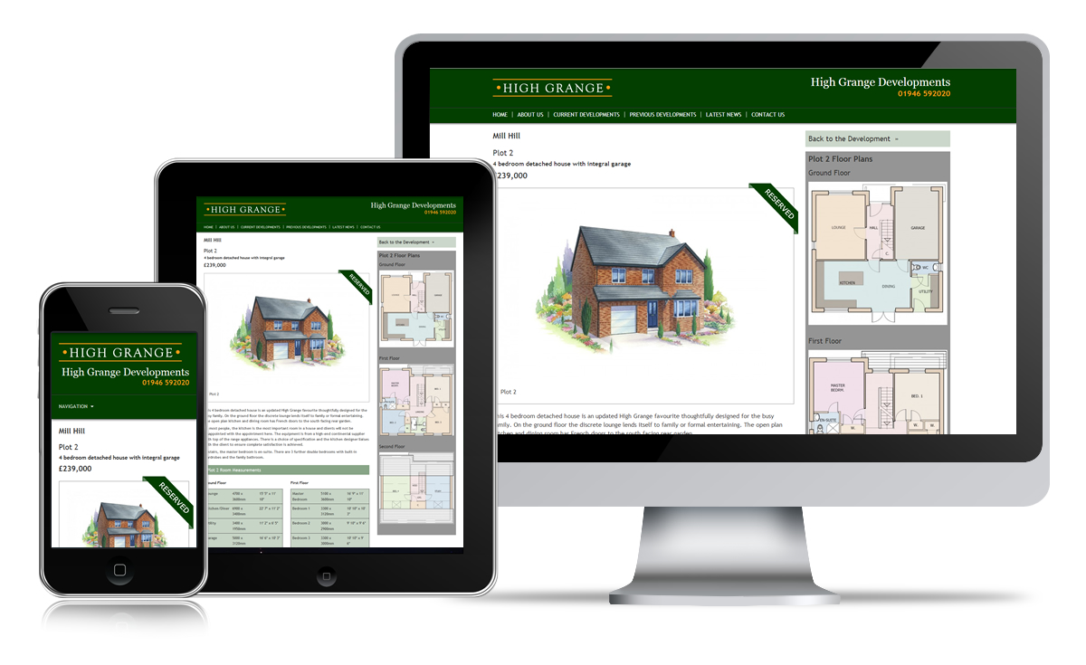

Slide 29
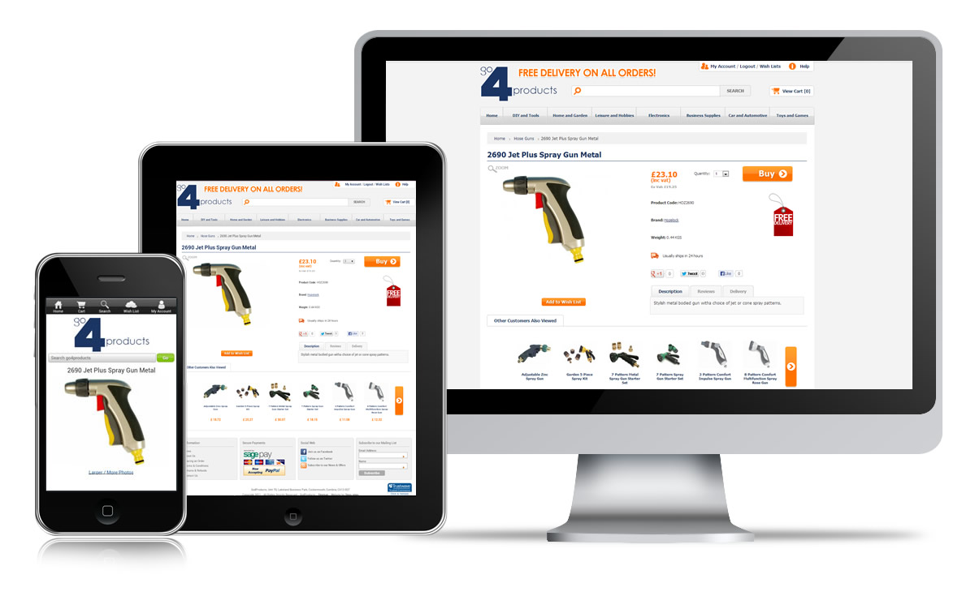

Slide 30
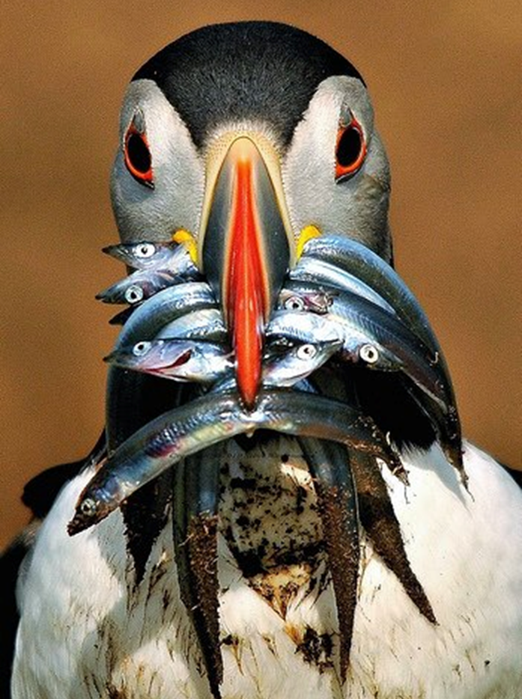
Bricks & Mortar + E-commerce presents opportunities
Consider existing platforms such as ebay & Amazon
Increasingly important to be visible across a range of devices with your own website
Customers will inevitably decide how they want to shop, we can either fight it or embrace it

Slide 31
Clive Hall, 3MI Advantage
Mobile Marketing

Slide 32
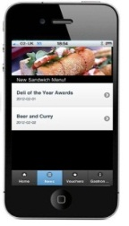
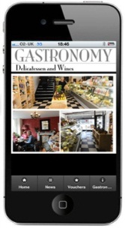
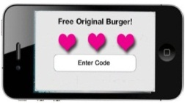
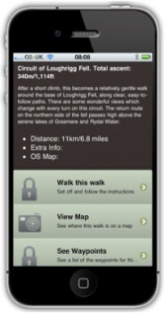
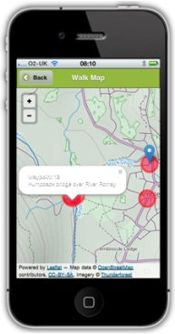
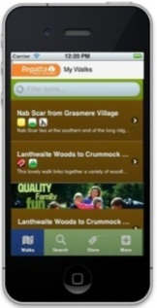
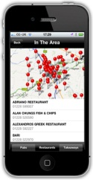
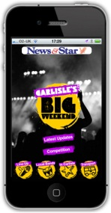
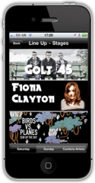

Slide 33
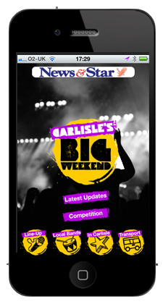
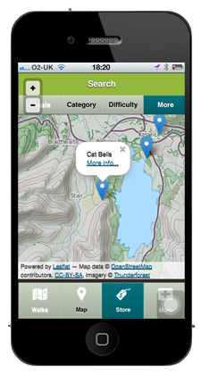
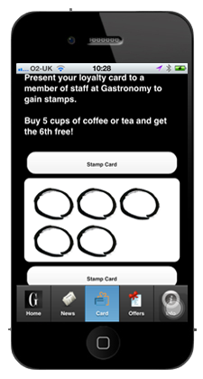
One Mobile Marketing Hub
Festival and Events + Trails + Neighbourhood Loyalty

Slide 34
Our Clients

Slide 35
How people Shop Now
Rumours of the death of the high street have been greatly exaggerated. All the evidence suggests that we as individuals enjoy and will continue to crave the physical experience of shopping. digital agency research Red Ant, www.redant.com
In Red Ant's recent collaboration with Drapers on their Multichannel Report, they asked more than 2,000 people about their attitudes to fashion buying and how they shop. These shoppers were of all ages and both genders, and shopped in stores, online, using mobile devices and social media platforms.
69% of all respondents prefer in-store shopping for clothing and footwear
61% also enjoy shopping online
77% of 18-34 year olds thought it was a great idea’ to have access to an online experience in-store
60% of 18-34 year olds use their mobiles while out shopping, to look at retailers’ websites, check prices and access discount codes

Slide 36
STATEMENT: INDEPENDENTS ARE INDIFFERENT TO DIGITAL! Penelope Else, member, SEE3 Portas Pilot, founder, Sydenham's online high street, Forest Hill Fashion project
…they aren’t going to engage with the internet while it seems to be taking them further away from their true love…
rather than bringing them closer.
spend 80% of your time and effort on helping local traders create marketing plans in which the internet makes perfect sense.
Techies always get excited by the latest technology and want to use it somewhere, anywhere.
To those of us who regard the internet as an extension of our brains, web-apathy may seem incomprehensible, an insane lack of vision…
but then again, these folk like running a shop, not a computer.
They want to be fondling their stock, not tweeting strangers!!

Slide 37
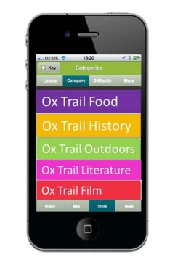
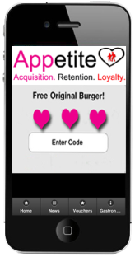
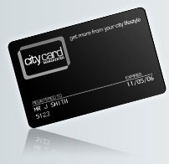
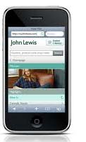
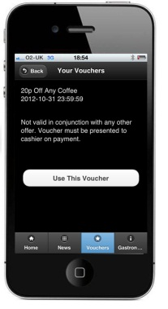
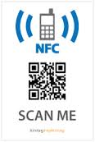
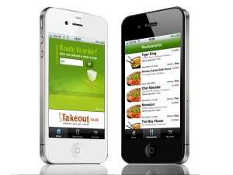
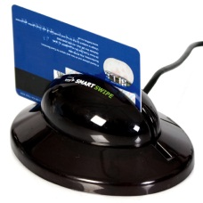
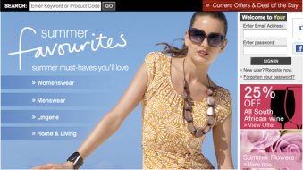
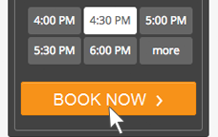
Digitally connected
Digitally Connected events /
Visitor Economy
Discount Card
Mobile Loyalty
Social Sharing
Traditional Digitally Connected
Magnetic Swipe
Mobile Vouchers
M- Commerce
Interactive
Technologies
Takeaway Ordering
+
Terminal
E - Commerce
Table Booking
+
QR Codes
NFC
Software

Slide 38
James Lovell, Lead Solution Consultant for IBM in Europe for Smarter Commerce
Online is not killing the high street. Retailers need to adapt to having more than one sales channel and have each channel compliment the other. It's that buzzword, "omnichannel".
“Every conversation I have with retailers involves online. The key message is the convergence of the digital and physical worlds That's the big one for 2013.
”
What technologies are on the horizon for retail?
Shopping on your phone.
Augmented Reality is on its way and would allow almost self-service “clientelling”
point your phone at a shoe, the software would recognise the product and bring up more information about it
reviews, where it was made, materials, anything you can think of.
You could post it to Facebook if you wanted feedback from your friends.
Everything you could get online you could get in store through a smartphone. Again, it’s tying together the digital and physical worlds.
What is Omichannel?
Omnichannel might mean…
buying online
but taking back to a physical shop for repair or return.
It might mean going into a shop to take a look at a product
ordering online on a mobile phone from inside the shop
and having it ready for pick-up at another store.

Slide 39
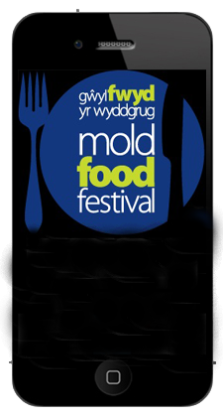
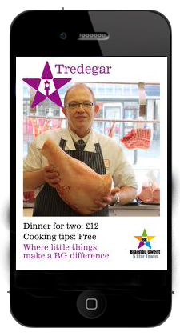
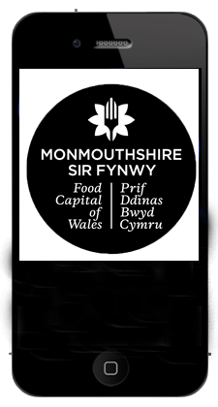
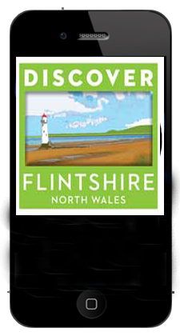
Your own branded App…
Mobile Marketing Hub
Chorley Beer Festival
Chorley Trails
Destination Chorley
Chorley Rewards and Loyalty
In destination
interactive content…
Access all content
from any App…
Publish, festivals, trails and loyalty all through one hub.

Slide 40
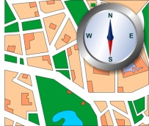
Attracting visitors to local business
Visitors can get the most out of each and every visit through maps and business listings
Directly connect festival and event visitors to local businesses
Location based offers where ever the visitor goes!
Live News, events, promotions and what’s on
Earn Points on your loyalty card

Slide 42
Appetite Features
Maps:
Neighbourhood + Business Map + Event Map + Offers Map
Voucher offers:
Redeemed through phone + tracking + detail reporting
Data:
Capture opt-in consumer data
GPS Locating:
Vouchers + Content + Video + Audio + Image Gallery
Business Promotion:
Business Pages + Directions + Voucher Offers + Click to call
News:
News feed + what’s on + things to do
Loyalty Card:
Individual loyalty card for each business
Content Management System:
News + Business Listing + Voucher offers + Loyalty Cards
Analytics:
Consumer data + voucher usage + Voucher redemption

Slide 43
Voucher options
Instant usage
Linked vouchers
Time controlled
Voucher code
Bar code
Discount
Single / multiple usage
Email voucher
Web download

Slide 44
LOYALTY MADE SIMPLE
Promoting your destination to visitors, residents and workers. Appetite aggregates reward and loyalty programs in a single application making easy for the user, and profitable for the destination business.
Customer locates business
using directory and map
Cashier presents
the QR Code Card
Customer scans the QR Code
HOW IT WORKS?
Customer receives loyalty points
Customer returns &
collects more points
Customer receives a reward
Opt in Customer Data is captured!
As customers collect their loyalty points and rewards, you collect valuable opt in data.
Deliver personalised messages, promote independent businesses, emphasise the diversity of your BID location

Slide 45
Sponsored Rewards
“Sponsored rewards allows an advertiser to engage customers in the buying mood in highly targeted locations”
User receive bonus stamp, at the point of sale in return for viewing sponsored ad
Target customer by gender, location and business type
Track conversion rate of offer
Host merchant receives advertising revenue
GET A BONUS REWARD AT
SPONSORED BY
GASTRONOMY!
NO THANKS
GET BONUS

Slide 46
Crowd Rewards
“It works like the group-buying concept, we move top-line revenue up front, flip around the economics of group buying by requiring the customer to visit the retailer first and pay full price ”
CROWD REWARDS
Get a reward
with 1 STAMP!
Users work together to trigger offer
Once target met, all participating users receive the offer
attract customers, provide them with discounts
most importantly take care of the retailer’s bottom line.
Coffee Bean
JOIN THE CROWD TO GET: 1 Free
Medium Coffee or Tea
Get rewarded from
7 JAN – 12 JAN
Unlock reward with
250 STAMPS

Slide 47
Appetite Features
Offer Vouchers
News + What’s on
Mobile Loyalty Card
Map and Directions

Slide 48
AppFest Features
Live news + updates
Event Mapping
Business listings + map vouchers + click to call
Schedule + bios + event calendar

Slide 49
AppTrail Features
Audio and Video
Voucher Offers
Image Gallery
In App Postcard
Geo Cache Longitude and Latitude
Waypoint
Online Google Mapping with interactive waypoint
Offline Map
with interactive waypoint

Slide 50
Knowing the consumer Data capture and analytics
What vouchers are redeemed
Which businesses are interacted with
When last visited and where
How much of the trail is completed
How many people visited the festival and how long they stayed
Name, email and phone number

Slide 51
You are in control
Detailed reporting mechanism
ALL activity is logged across Festival, Trail and Reward Apps
Create email, text and push notification campaigns based on real data
Export registration data
into email marketing platform
Analyse customers behaviour to bring back more visitors
Data provided in graph, table and CSV export file format
Capture opt-in consumer data
Build profile data about your visitor
Who, When, What, How Many…
All questions answered

Slide 52
Get in touch
General enquiries for anything Mobile Marketing
Clive Hall
Director
clive@3miadvantage.co.uk
07726 355 277

Slide 53
Adrian Robson Edwards Menswear
&
James Norris - John Norris of Penrith

Slide 54
Dates for your Diary
July 20th to 27th - Eden Food & Farming Festival
August 6th - Chamber Summer Social
September 3rd - General Business Meeting with Speaker
October 1st - B2B event - A visit to the Lakes Free Range Egg Company
November 5th - General Business Meeting with Speaker
November 30th to 25th December - Winter Festival
December 17th - Chamber Christmas Drinks

